Slide 1
Reinforcement Learning based Trading Bot on Order Book Data

Slide 2
Agenda
Backstory: Setting the Problem Statement
Workflow
Feature Selection
Prevalent Methods: Technical Indicators
Suggested Methods: Order Book Market Depth Data
Performance Analysis
Algorithm Selection
Reinforcement Learning
Implementation
Performance Analysis of RL with SL algorithms
Future Scope
References

Slide 3
Backstory: Setting the Problem Statement
Manual Trading
Human decision-making for entering and exiting the trades
Might be superior since human judgement is required to gauge market trends and control risk
Automated Trading
Computer program that originate trades based on algorithmic or human-instructed criteria
Might be superior since it takes irrational human behavior out of equation
Can Machines beat humans?
Time will tell…

Slide 4
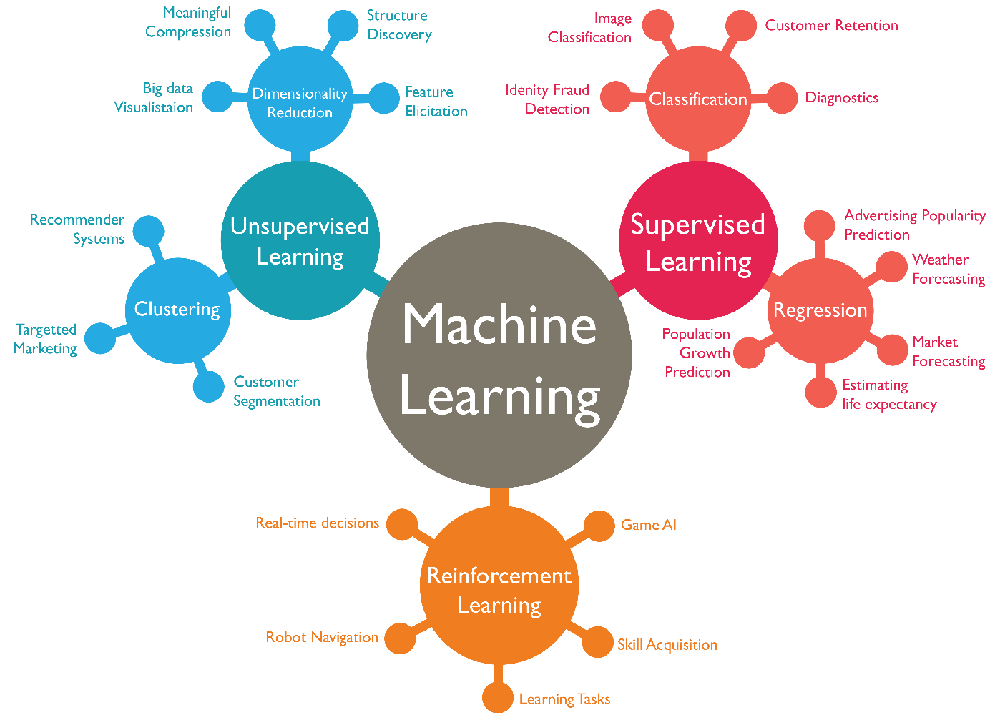
Machine Learning Comes Into Play
Trading requires a lot of attention and sensitivity to the market
High risk with multiple variables, to let humans make decisions
Humans can’t compete in speed and accuracy
Currently no aspect of our lives has remained untouched by ML
We will discuss the application of ML for trading
Specifically, we look at Reinforcement Learning as one of the approaches

Slide 5
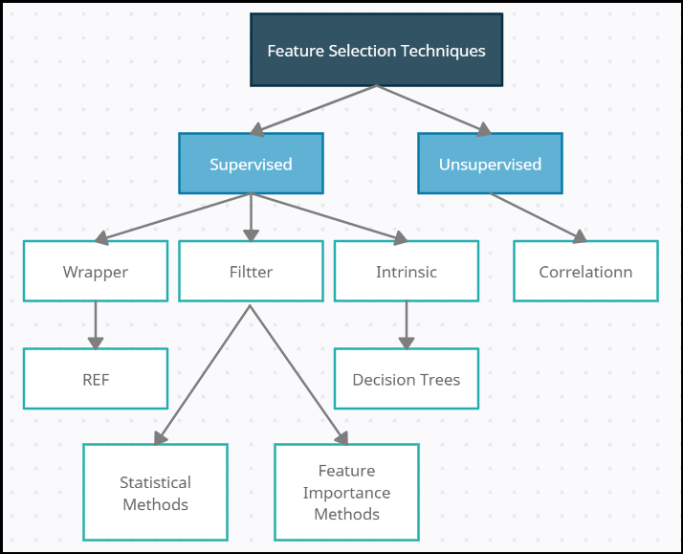
Workflow
1. Feature Selection
2. Algorithm Selection

Slide 6
1. Feature Selection
OHLCV
Technical Indicators
Order Book Market Depth Data

Slide 7
OHLCV Data
Open
High
Low
Close
Volume
Date | Open | High | Low | Close | Adj Close | Volume
2015-01-02 | 532.59 | 535.79 | 527.88 | 529.54 | 529.54 | 1324000
2015-01-05 | 527.15 | 527.98 | 517.75 | 519.46 | 519.46 | 2059100
2015-01-06 | 520.50 | 521.21 | 505.54 | 506.64 | 506.64 | 2722800

Slide 8
Technical Indicators Used
Relative Strength Index
Moving Average Divergence Convergence
On Balance Volume
Average Direction Index
Exponential Moving Average
Awesome Oscillator
Know Sure Thing Indicator
Stochastic Oscillator

Slide 9
Order Book Market Depth Data
Market Data feeds provide traders with current stock prices and recent trades in order books that are sorted into Level I and Level II data
Level I
Bid Price
Bid Size
Ask Price
Ask Size
Last Price
Last Size

Slide 10
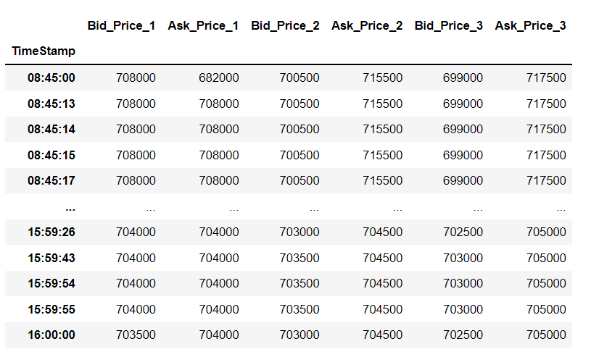
Order Book Data

Slide 11
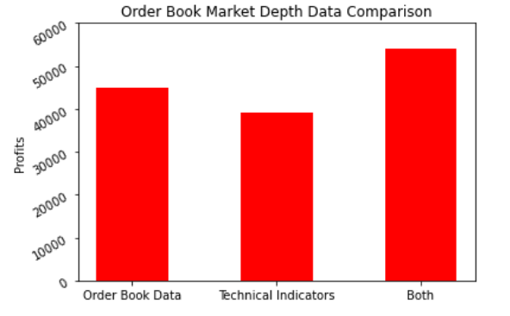
Performance Results

Slide 12
2. Algorithm Selection
Reinforcement Learning (Q-Learning)
Implementation
Performance Analysis of RL with Supervised Learning Algorithms

Slide 13
Reinforcement Learning
Technique to make machines learn to solve a task without supervision
When a task is performed, we go through a number of steps
At each step the “State” of the system changes
Based on the “State” we make the decision
We finally get a reward-based success/failure of our decision

Slide 14
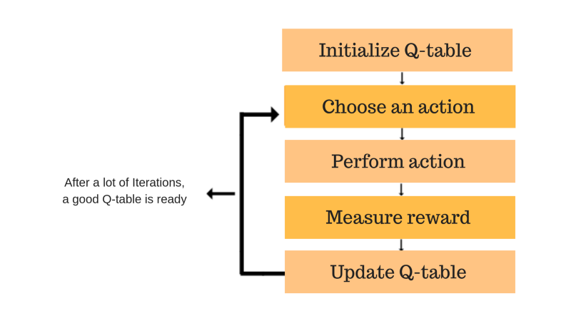
Q-Learning Algorithm

Slide 15

Bellman Equation
r is the immediate reward of an action a
Q is the cumulative reward of an action a
s’ is the state we end up with after performing a
Gamma ($γ$) is called the discount factor
For $γ$ close to 1 we get more greedy

Slide 16
Markov Decision Process
Take action (A)
Transition to state (S)
Get reward (R)
A policy (π) defines the set of actions
Probability of taking an action from a particular state
The reward we get defines our value (V)

Slide 17
Gamification
Computer Games
State
Cursor movement
Reward
Trading
Historical and current prices, technical data
Buy/Sell/Hold
PnL

Slide 18
Implementation
“Gamification” of trading
Finding the right reward function
Finding the right inputs to define out “State”
Testing the system for known behavior

Slide 19
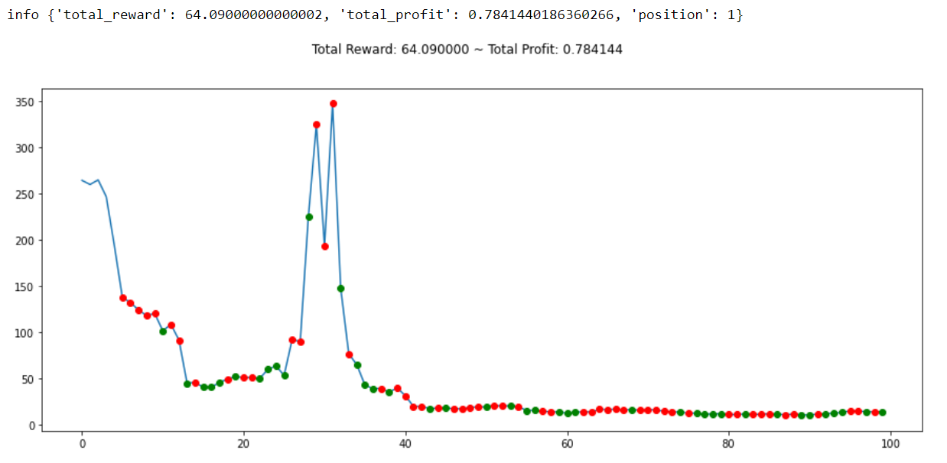
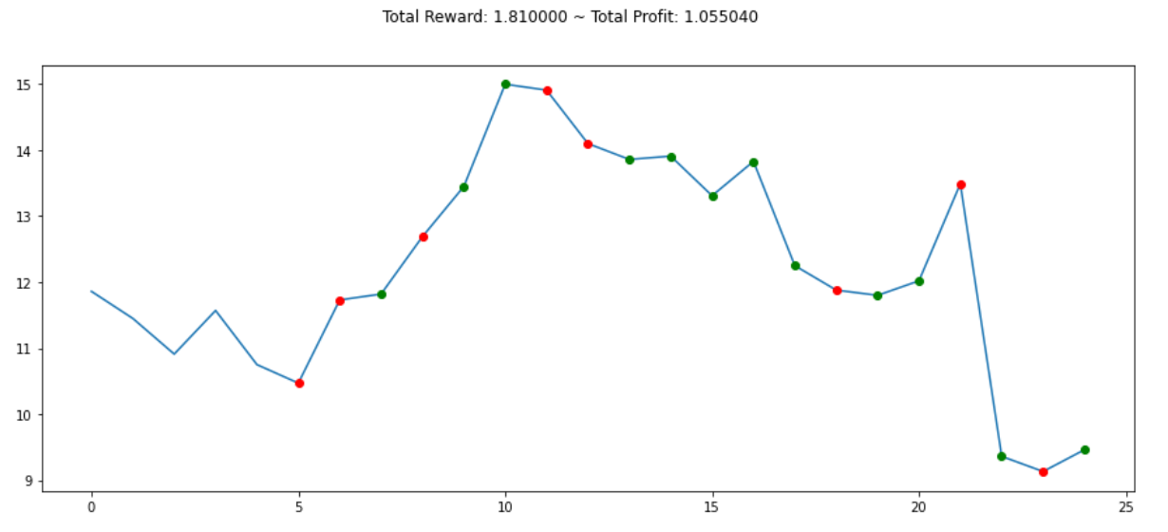
Exploration Vs Exploitation

Slide 20
Benchmarking RL with SL algorithms
Supervised Learning Algorithms used
Linear Regression
Logistic Regression
Decision Tress
Gradient Boosted Random Forests

Slide 21
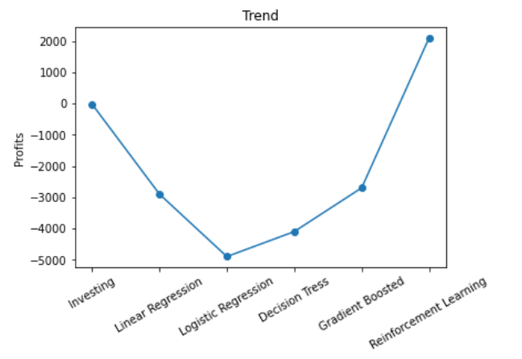
Reinforcement Learning
Supervised Learning

Slide 22
Future Scope
Testing other Reinforcement Learning algorithms with SL algorithms using similar methodology
Incorporating Futures and Options data and exploring the Forex Market as well
Implementing Multi Agent model or cost function to predict the number of units to trade at each time instance

Slide 23
References
Bates, R.G., Dempster, M.A. and Romahi, Y.S., 2003, March. Evolutionary reinforcement learning in FX order book and order flow analysis. In 2003 IEEE International Conference on Computational Intelligence for Financial Engineering, 2003. Proceedings. (pp. 355-362). IEEE.
Song, Y., 2017. A Forex Trading System Using Evolutionary Reinforcement Learning (Doctoral dissertation, WORCESTER POLYTECHNIC INSTITUTE).

Slide 24
Thank You

